Slide 1
Year 2 Unit title – Where did the world come from?
Teacher Information
In this unit children are given the opportunity to learn about creation stories and beliefs in different religions.
Children are given the opportunity to reflect on their own beliefs about how the world began, and how people fail and try to look after the world.
The story of evolution and the Big Bang do not feature formally as these don’t fit into being a religious or non-religious story – some people from religion believe in the Big Bang and others don’t across every religion. Teachers need to be aware that questions around this story/account may come up in the unit, and should be welcomed as a story lots of people believe in as well.

Slide 2
Where did the world
come from?

Slide 3
Lesson 1 What is creation?

Slide 4
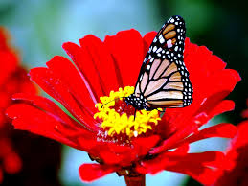
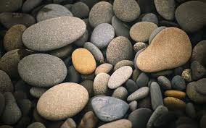

Slide 5
Use a magnifying glass to look at the objects.
What you can see?
Describe it to a friend
Is it beautiful? Why do you think that?
What makes these things special? How did they get there?
Where did these objects come from?
Did God create them?

Slide 6
Activity
Draw the thing you find most beautiful in nature
Write where you think it came from?

Slide 7
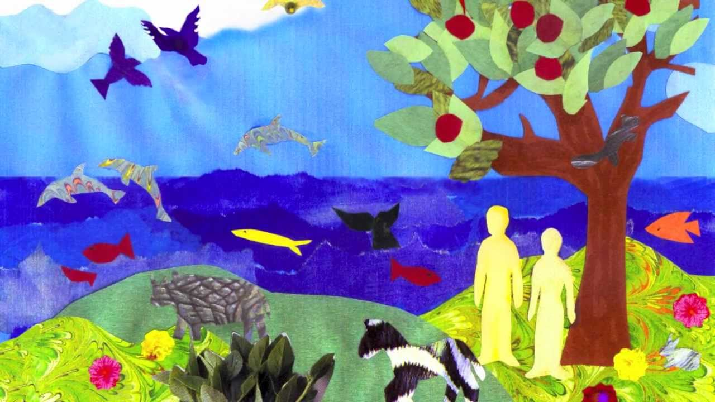
Lesson 2 What do Jews, Christians and Muslim’s tell about how the world began?

Slide 8
Listen to the creation story Genesis Chapter 1 & 2
Use a whiteboard and pen to write notes
on what happened on
Day 1
Day 2
Day 3
Day 4
Day 5
Day 6

Slide 9
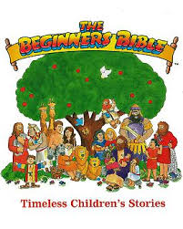
Or watch
https://www.youtube.com/watch?v=2pBXhx0XUxI
https://www.youtube.com/watch?v=bLHB_hNk42g

Slide 10
Let’s act out what happened

Slide 11
Activity
How do you think God felt?
Why did he need to rest?
It’s your turn to create something new
(your teacher will give you resources to use)
How do you feel when you create something?
What does this tell people about God?
What is he like?

Slide 12
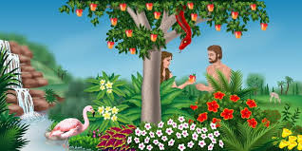
Lesson 3 What do Jews, Christians and Muslim’s tell about how the world began? (Adam and Eve)
http://www.storynory.com/2006/05/27/creation-and-adam-and-eve/
Go to 3 minutes into audio for Adam and Eve story

Slide 13
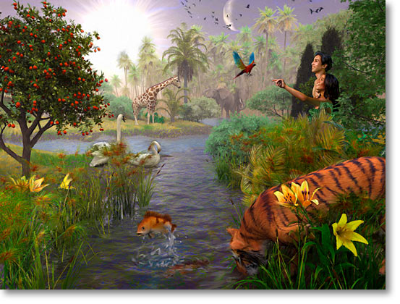
Imagine you are Adam, alone in the world. How do you think he felt when Eve was created?

Slide 14
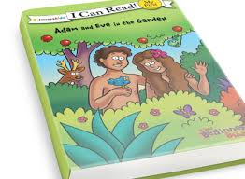
I’ll retell the story and when I say ‘freeze’, you need to freeze!
I may ask you how you are feeling or what you are thinking or take a photograph that we could order later.

Slide 15
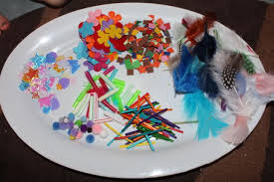
You can now produce a collage of your own Garden of Eden and write key words to describe it.

Slide 16
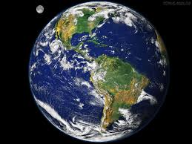
Lesson 4 Understand how Christians try and look after the world
Do you agree that
we should look
after the world?

Slide 17
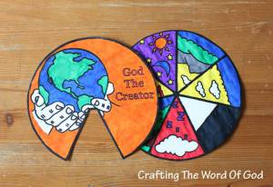
Can you retell the creation story to a friend?
Can you remember what happened on the different days?
Which day is your favourite? Why?

Slide 18
Activity
In small groups sort the images into two groups
1) How people look after the world through their actions
2) People who are not looking after the world
Do you all agree? Can you explain your decisions?

Slide 19
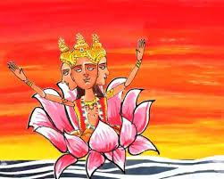
Lesson 5 What story do Hindu’s tell about how the world began?
https://www.youtube.com/watch?v=pfy0jKaxBFs

Slide 20
Activity
Look at the different forms of Brahman
What do you think about this story?
Are there any questions you would like to ask?
On cards sequence the story
Can you retell the story? Do you need the prompt cards or can you tell the story without?

Slide 21
Lesson 6 (skip this lesson if you only have 6 weeks to complete the unit) Understand how to represent a creation story creatively.
Assign each group one of the gods in the Hindu story to represent: Soma Surya, Agni, Vayu and Varuna

Slide 22
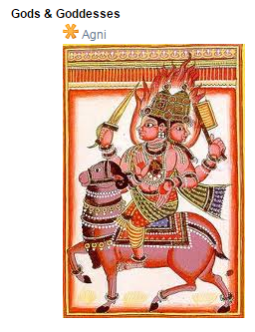
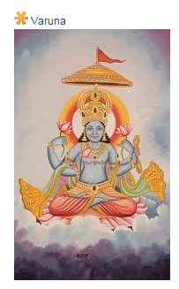
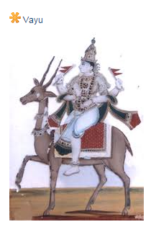
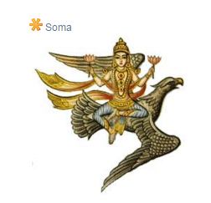
Hindu Gods of sun, fire, wind, oceans and moon.
Can you tell who is who?

Slide 23
Activity
Each group represents their God in a different medium: through pictures, collage, movement, music, freeze frame at teacher suggestion

Slide 24
Lesson 7
Talk about the different stories that you have learned. How do you think the world began? Can we really know? Do you all have the same ideas?
(Be creative and think originally)
Use a P4C enquiry to collect the children’s questions that make people wonder about how the world began

Slide 25
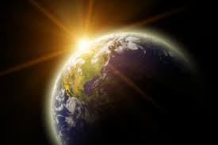
Where do you think the world came from?
Write
Discuss
Assessment opportunity explain the reason for your views. Can you show how your beliefs are similar or different from other people’s beliefs?

